Slide 1


Ecological and Climate Data from ORNL DAAC
Alison Boyer, ORNL DAAC
Michele Thornton, ORNL DAAC
Ecological Society of America Meeting, Portland, OR
August 10, 2017

Slide 2
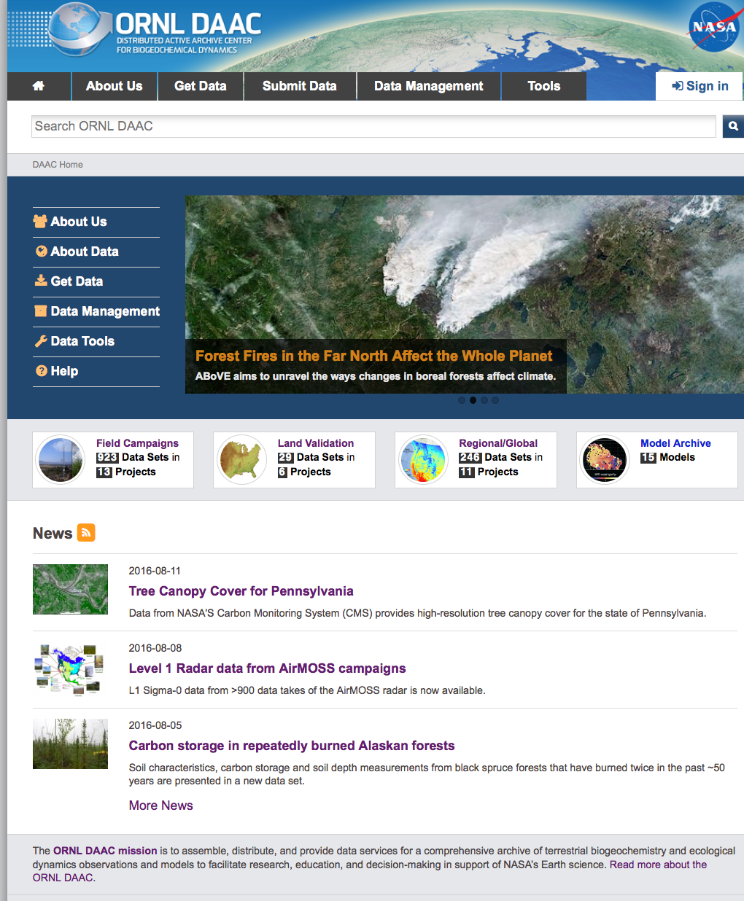
About ORNL DAAC
The Oak Ridge National Laboratory Distributed Active Archive Center (ORNL DAAC) archives data produced by NASA’s Terrestrial Ecology Program in support of NASA’s Carbon Cycle and Ecosystems Focus Area.
ORNL DAAC
Model Code
Land Validation
Regional and Global
Field Campaign
http://daac.ornl.gov
Notes:
What does the DAAC provide: access, services,

Slide 3


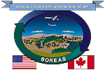



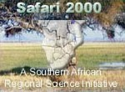


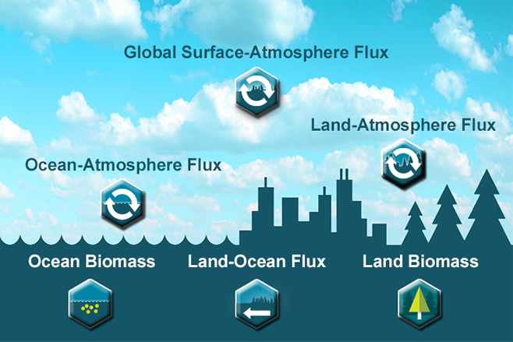


ORNL DAAC field campaign data
30+ Projects
1,300+ Investigators

Slide 4
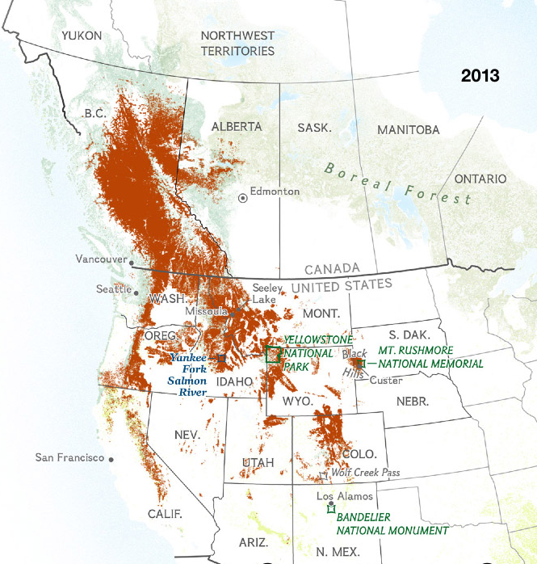
Case study: Mountain pine beetle epidemic
http://ngm.nationalgeographic.com/2015/04/pine-beetles/epidemic-map
Notes:
1990 – 2013 beetle spread. Historically the mountain pine beetle’s primary host has been the lodgepole pine. In the north, where lodgepoles dominate the landscape, cold temperatures helped keep beetle populations in check; down south the insects had far fewer trees to infest. With forests increasingly warmed by climate change, the beetles are thriving in once inhospitable areas, attacking species of pine they rarely touched before—and drastically altering the landscape.

Slide 5
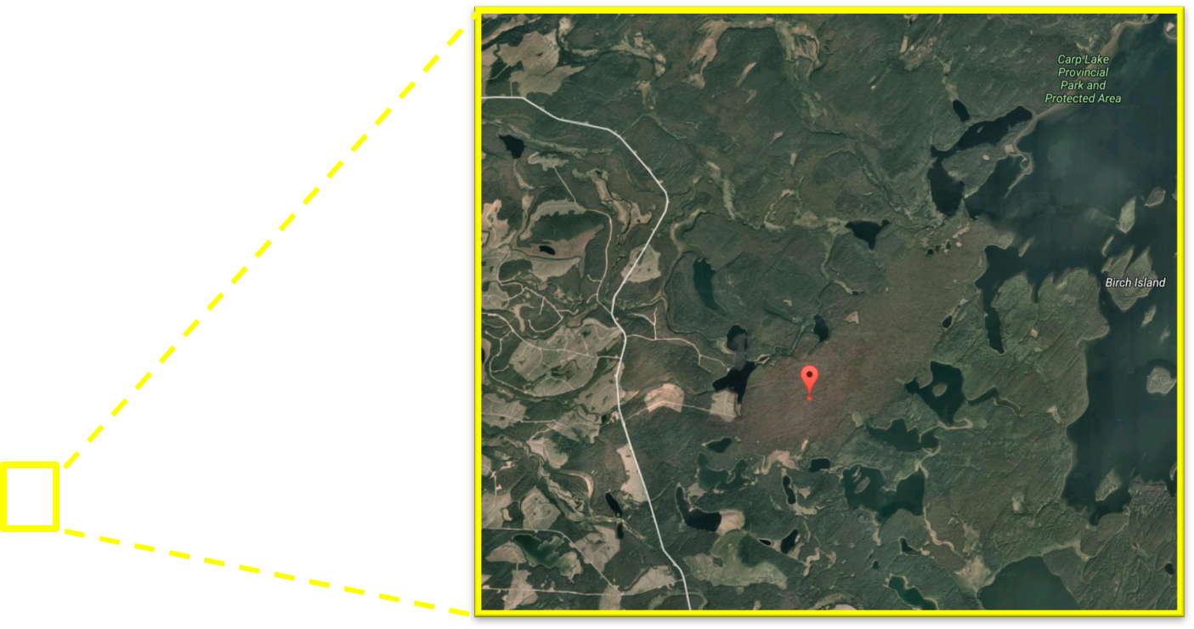
Case study: Mountain pine beetle epidemic
http://ngm.nationalgeographic.com/2015/04/pine-beetles/epidemic-map
Notes:
1990 – 2013 beetle spread. Historically the mountain pine beetle’s primary host has been the lodgepole pine. In the north, where lodgepoles dominate the landscape, cold temperatures helped keep beetle populations in check; down south the insects had far fewer trees to infest. With forests increasingly warmed by climate change, the beetles are thriving in once inhospitable areas, attacking species of pine they rarely touched before—and drastically altering the landscape.

Slide 6
Case study: Mountain pine beetle epidemic
MODIS Land Products
Surface Reflectance
Land Surface Temperature
Land Cover
Vegetation Phenology
Vegetation Indices: NDVI / EVI
LAI / fPAR
Evapotranspiration
Net Photosynthesis
Annual NPP
Albedo (Model and Calculated)
Reflectance – BRDF Adjusted
http://ngm.nationalgeographic.com/2015/04/pine-beetles/epidemic-map
Notes:
1990 – 2013 beetle spread. Historically the mountain pine beetle’s primary host has been the lodgepole pine. In the north, where lodgepoles dominate the landscape, cold temperatures helped keep beetle populations in check; down south the insects had far fewer trees to infest. With forests increasingly warmed by climate change, the beetles are thriving in once inhospitable areas, attacking species of pine they rarely touched before—and drastically altering the landscape.

Slide 7
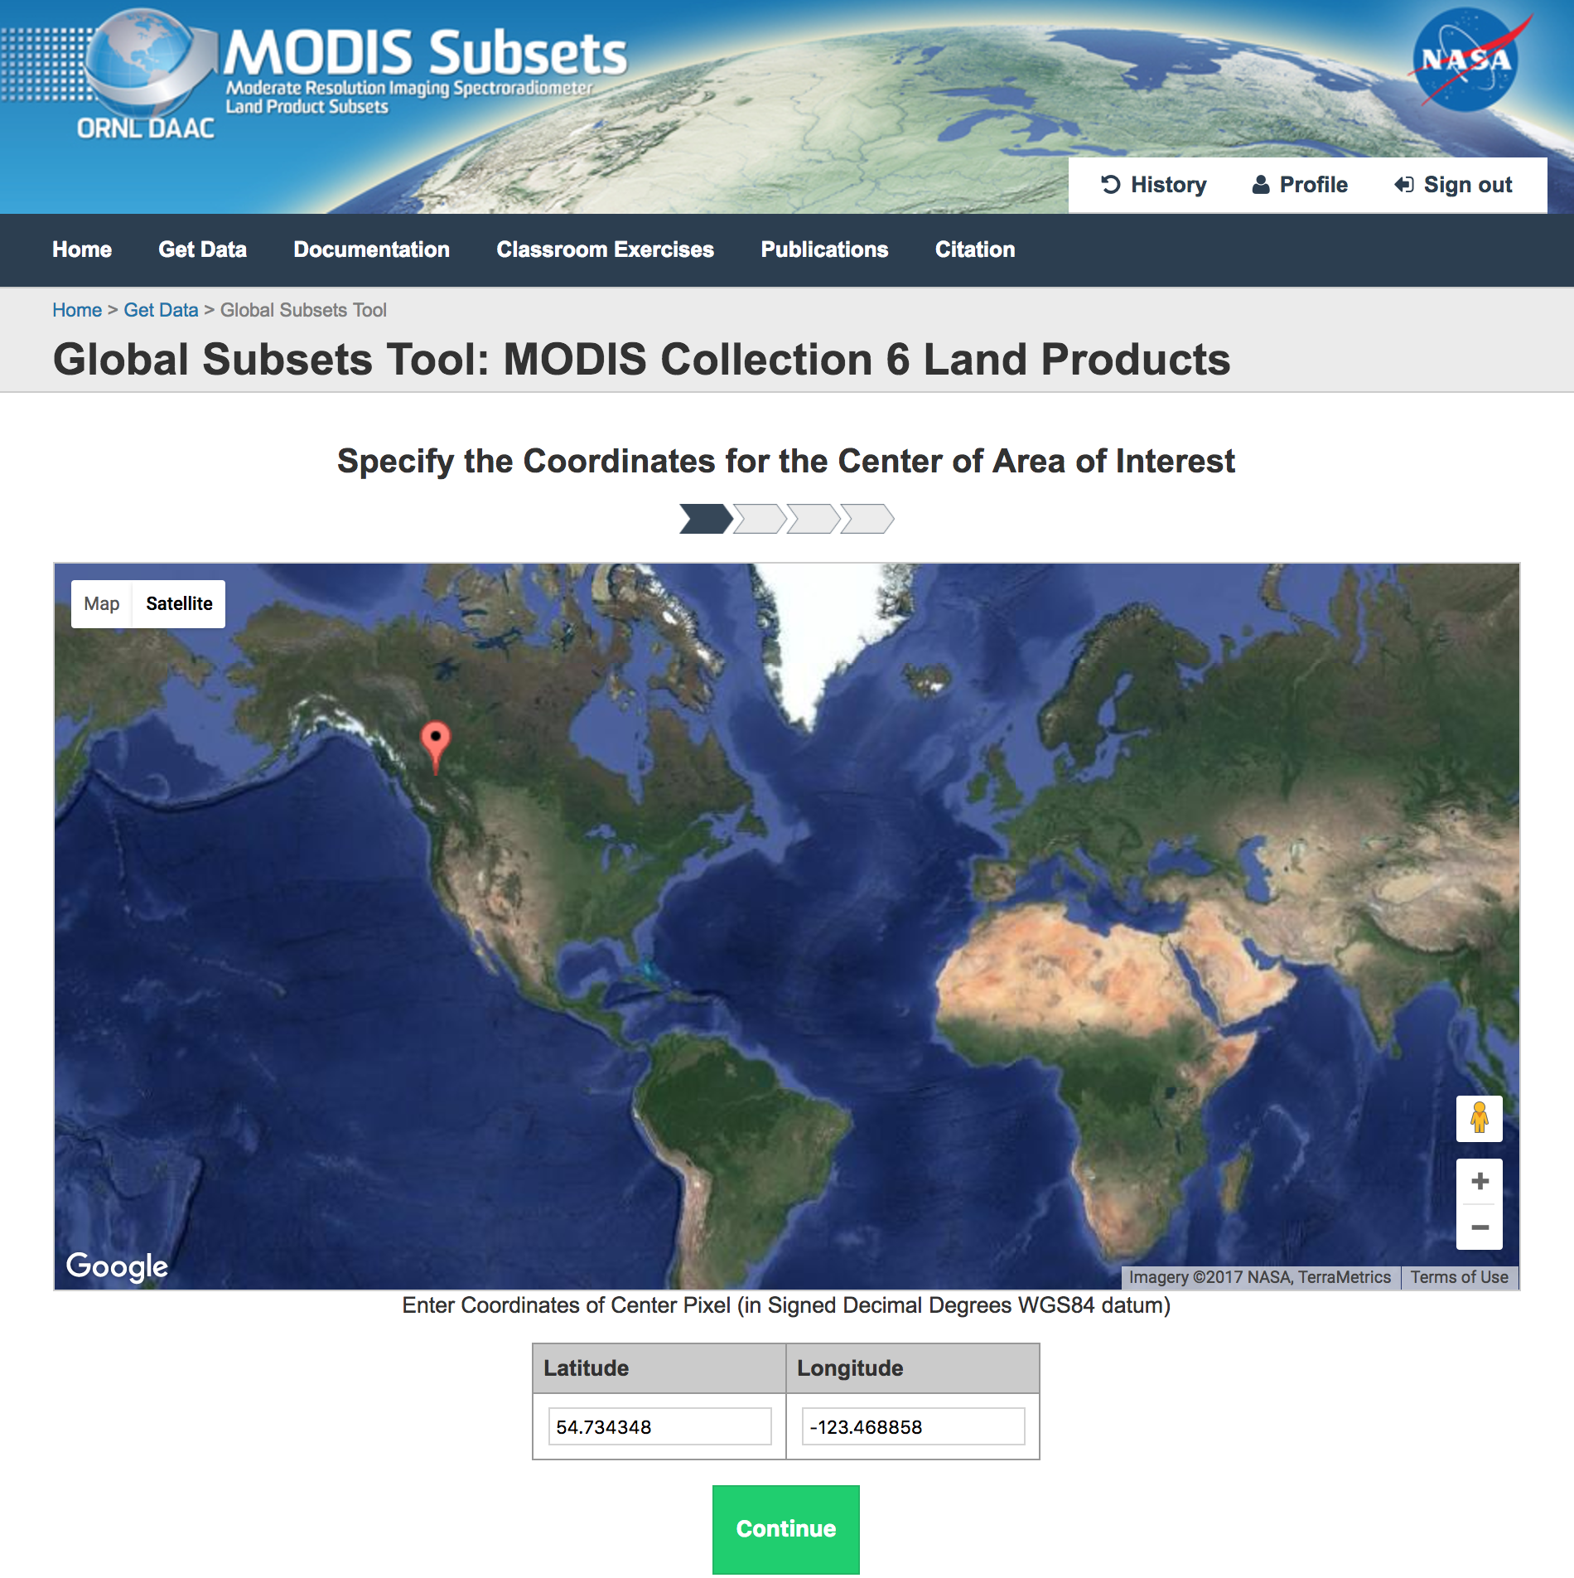
Case study: Mountain pine beetle epidemic
MODIS Land Products
Surface Reflectance
Land Surface Temperature
Land Cover
Vegetation Phenology
Vegetation Indices: NDVI / EVI
LAI / fPAR
Evapotranspiration
Net Photosynthesis
Annual NPP
Albedo (Model and Calculated)
Reflectance – BRDF Adjusted
https://modis.ornl.gov/cgi-bin/MODIS/global/subset.pl
Notes:
1990 – 2013 beetle spread. Historically the mountain pine beetle’s primary host has been the lodgepole pine. In the north, where lodgepoles dominate the landscape, cold temperatures helped keep beetle populations in check; down south the insects had far fewer trees to infest. With forests increasingly warmed by climate change, the beetles are thriving in once inhospitable areas, attacking species of pine they rarely touched before—and drastically altering the landscape.

Slide 8
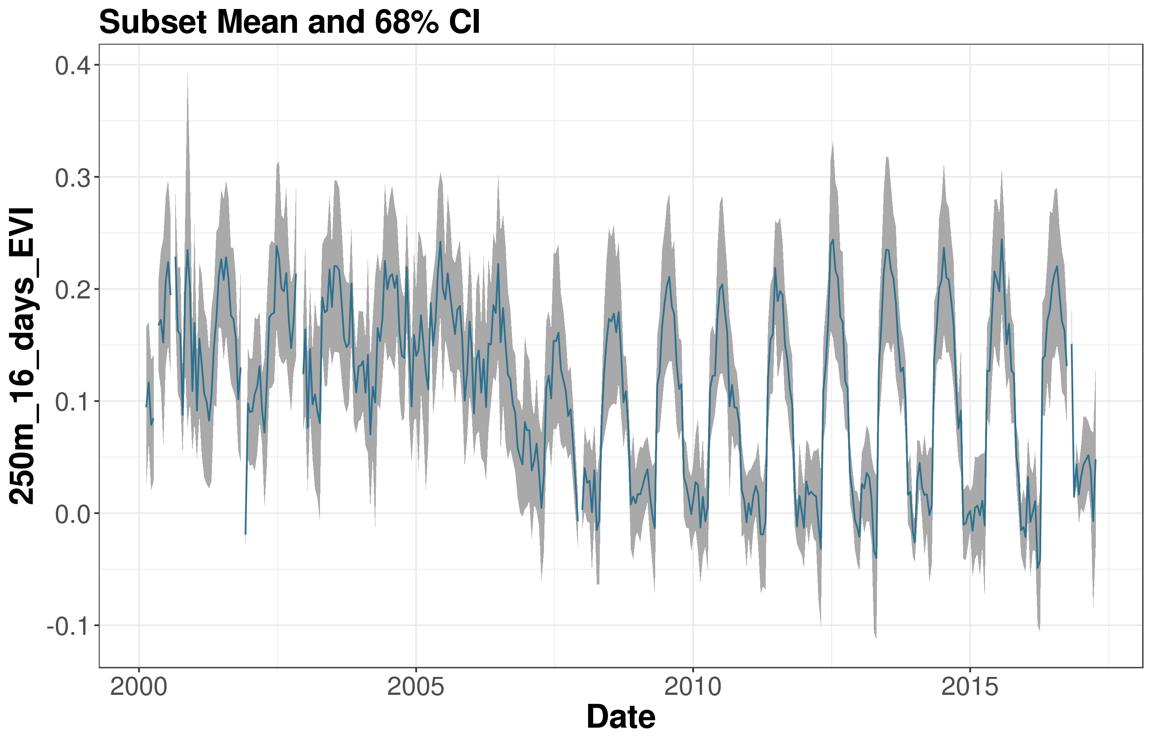
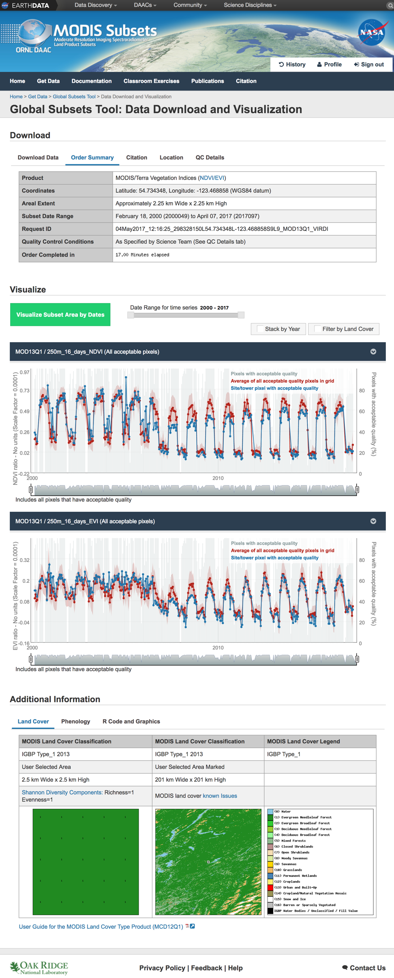
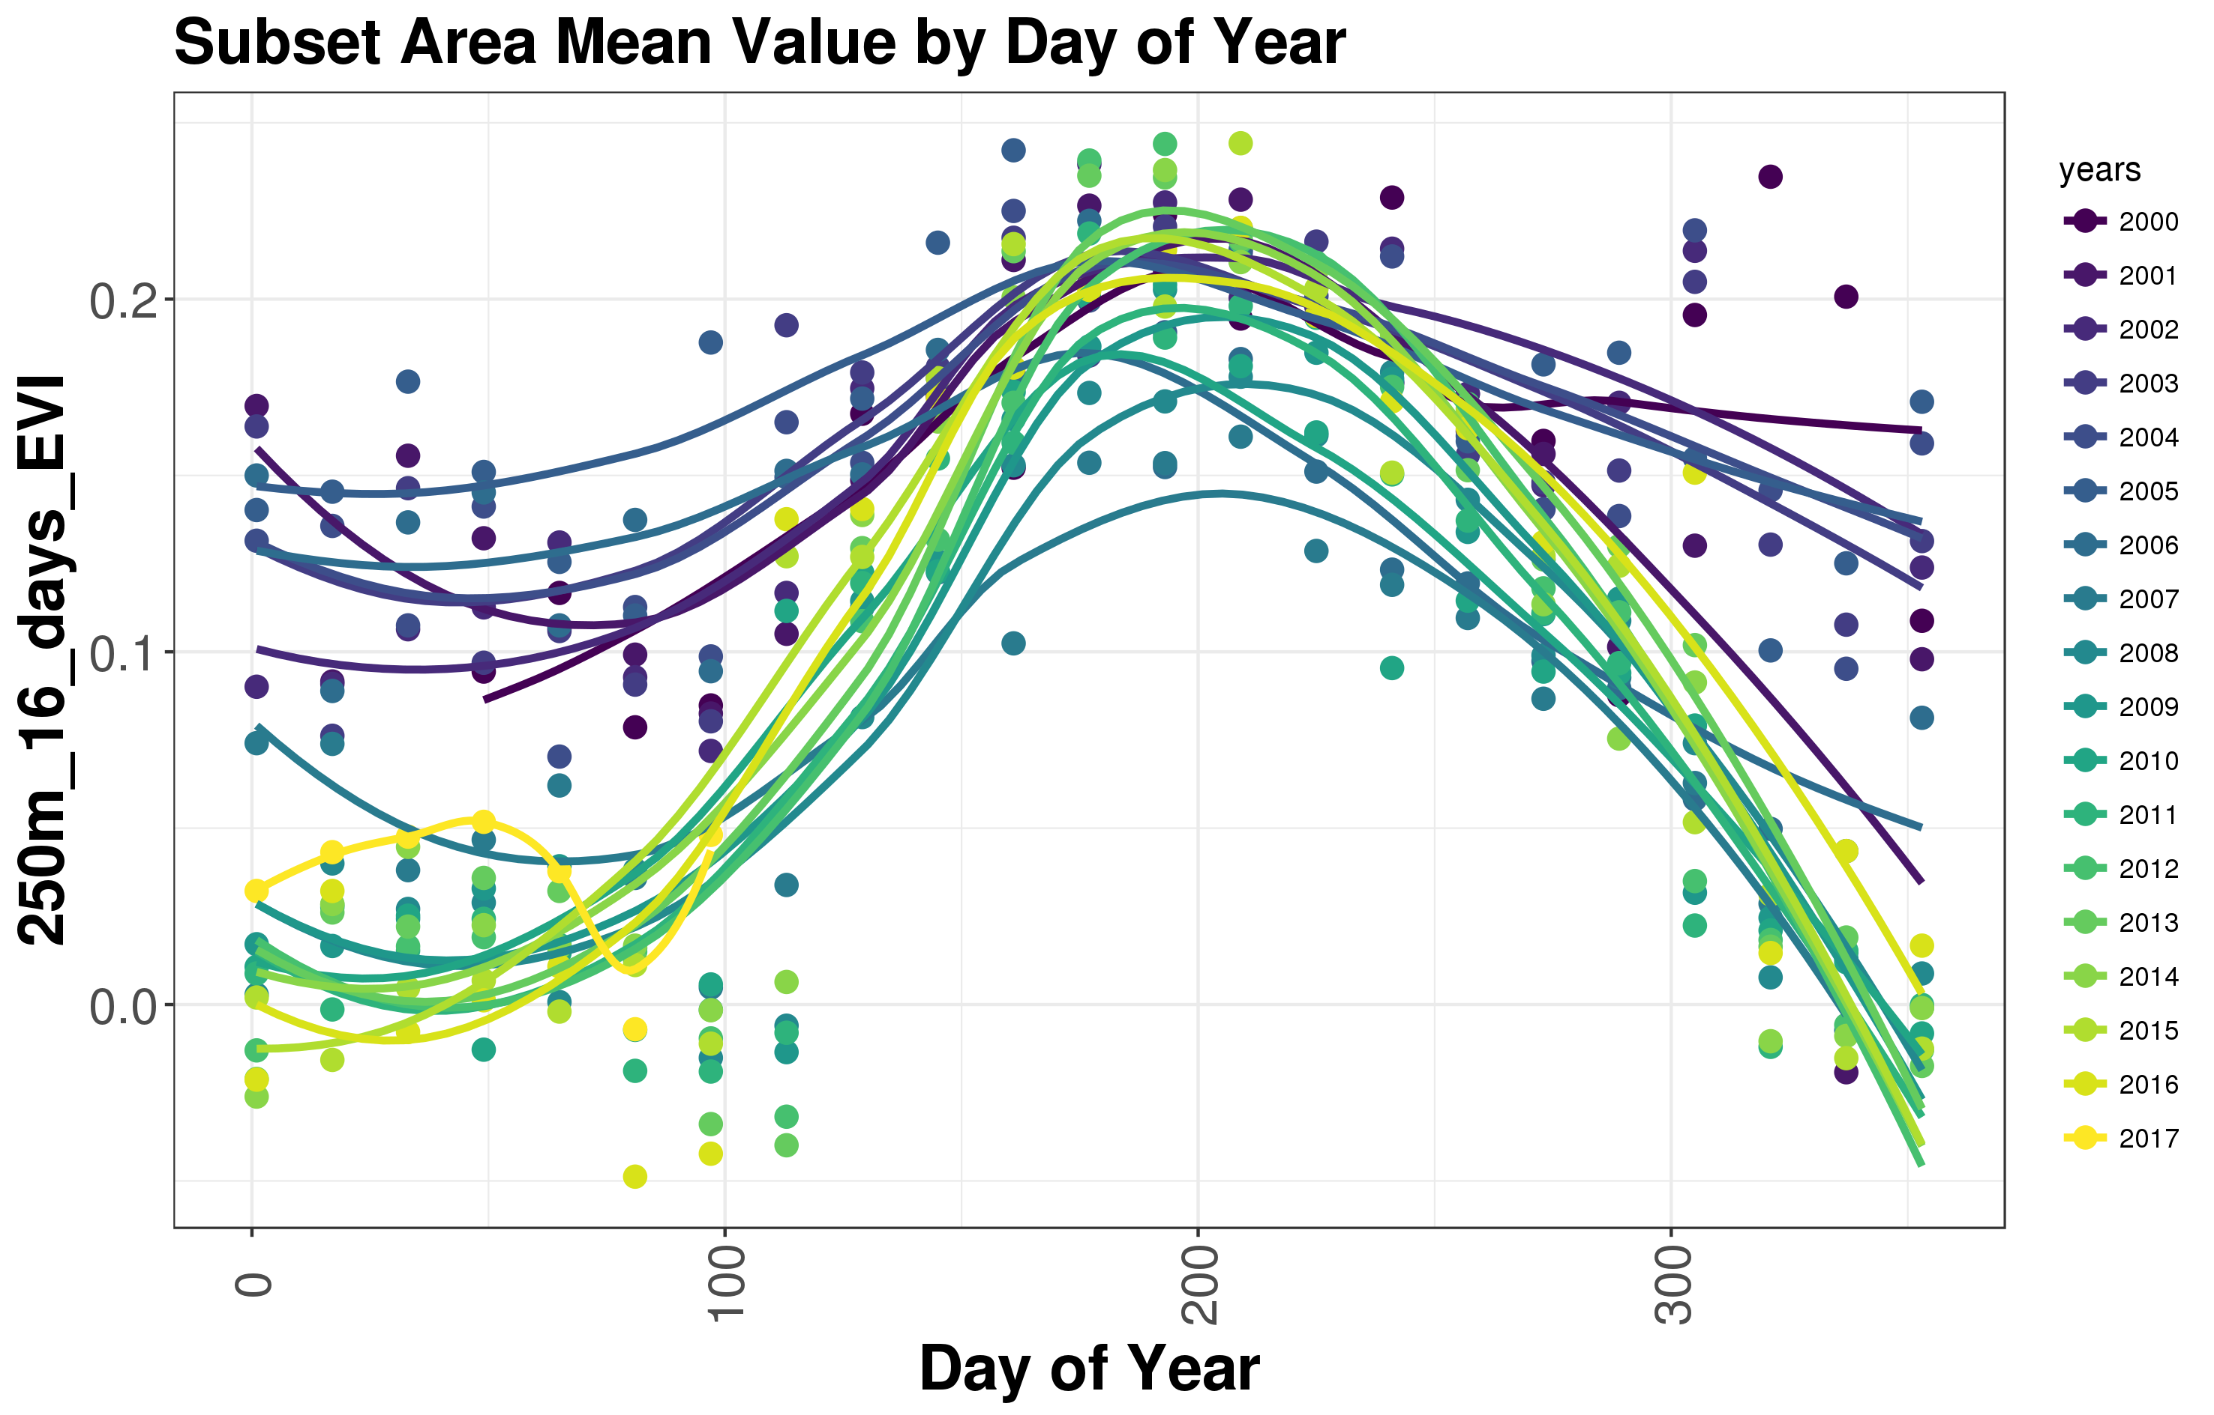
https://modis.ornl.gov/cgi-bin/MODIS/global/subset.pl
Notes:
This region was hit by beetles in 2006. The deciduous vegetation has recovered (see the strong annual cycle in EVI) but the pines are dead (no greenness in the winter). These summary stats and plots, and the R scripts to create them, are included in the subset delivery.

Slide 9
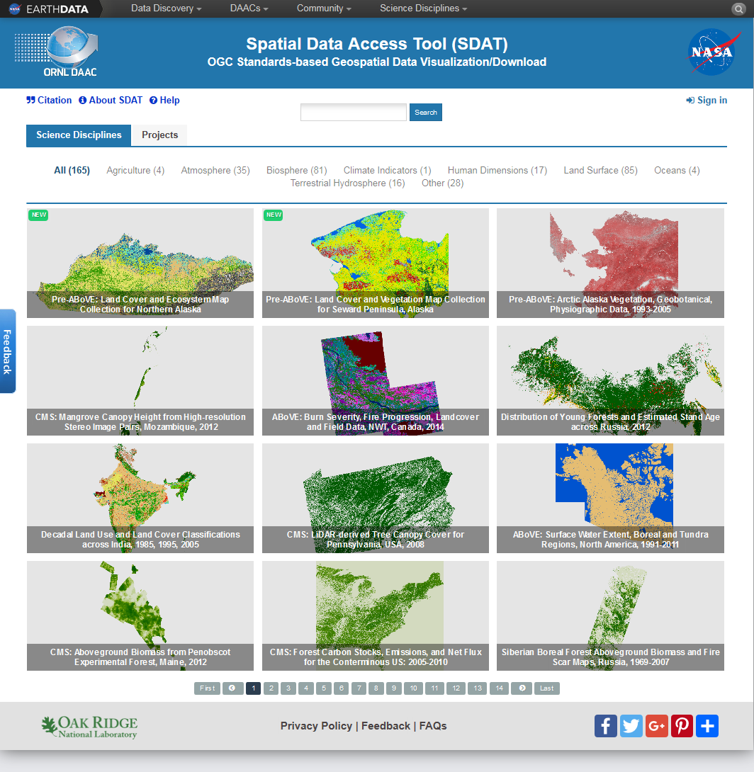
ORNL DAAC Spatial Data Access Tool
Browse and search over 160 datasets
Subset data by
  spatial, temporal, or by band
Reproject
Reformat to/from
  GeoTIFF, NetCDF, ASCII, KMZ
Spatial interpolation and resampling
https://webmap.ornl.gov/ogc
C-23 Sherpa

Slide 10
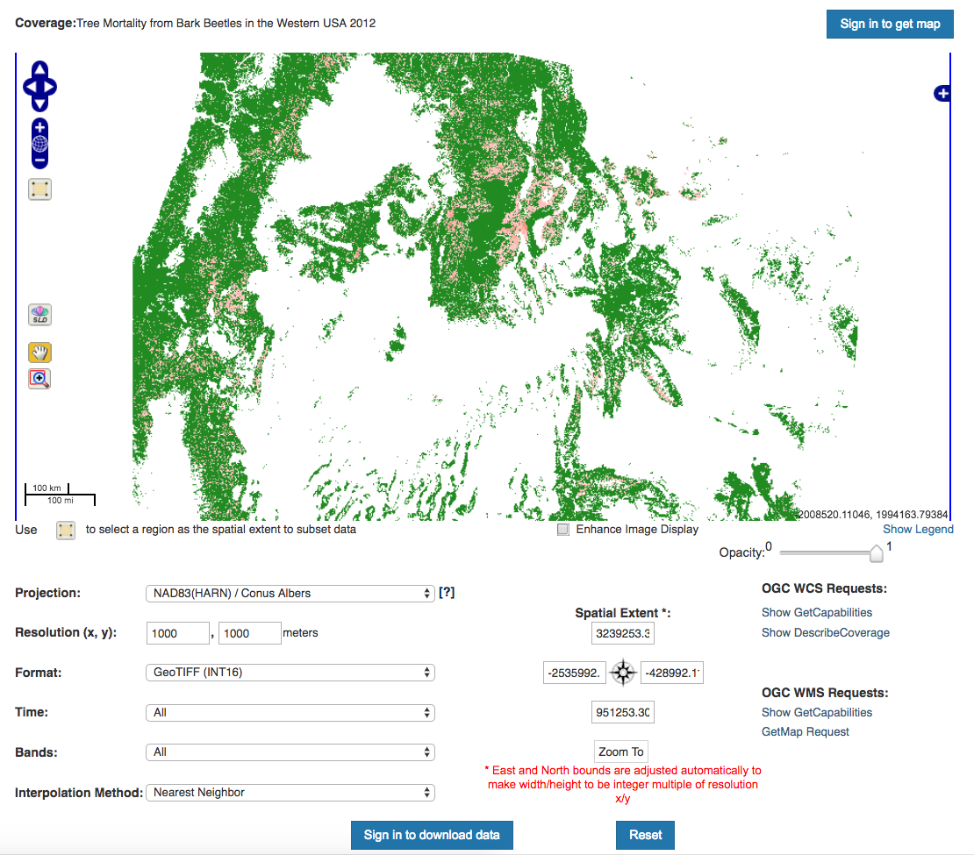
ORNL DAAC Spatial Data Access Tool
Browse and search over 160 datasets
Subset data by
  spatial, temporal, or by band
Reproject
Reformat to/from
  GeoTIFF, NetCDF, ASCII, KMZ
Spatial interpolation and resampling
https://webmap.ornl.gov/ogc
C-23 Sherpa
Tree Mortality from Fires and Bark Beetles at 1-km Resolution, Western USA, 2003-2012
https://doi.org/10.3334/ORNLDAAC/1512
Notes:
If you wanted estimates of the amount of stored carbon released by beetle-killed pines, see this DAAC data. You can even subset the gridded data to your local study area and save it as a KMZ.

Slide 11
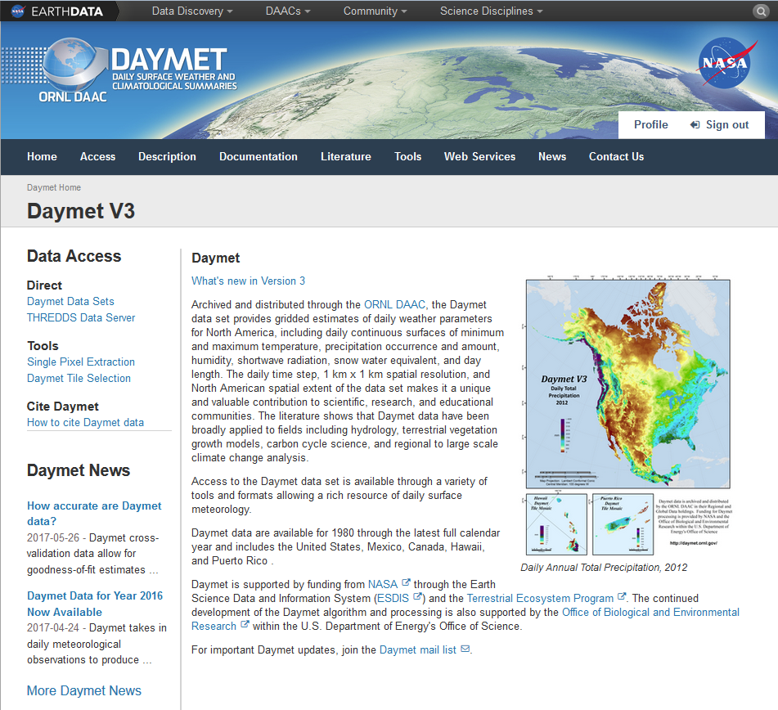
Daymet https://daymet.ornl.gov

Slide 12
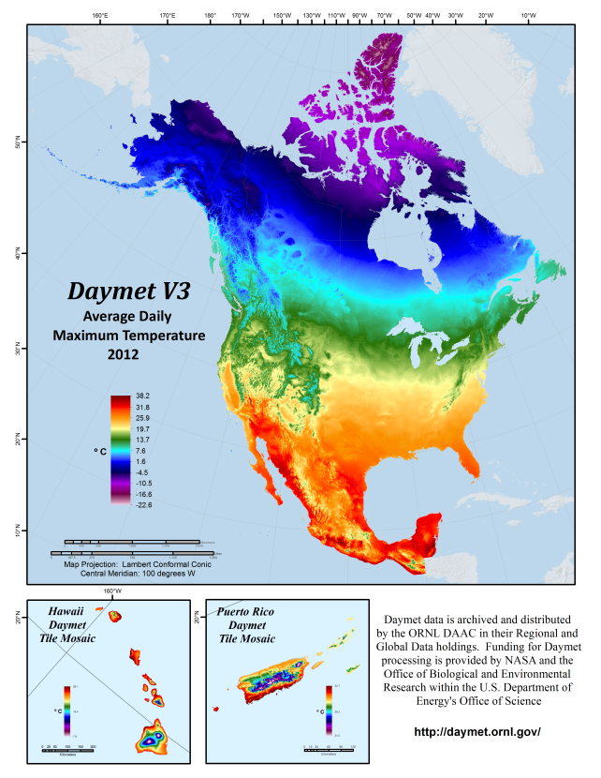
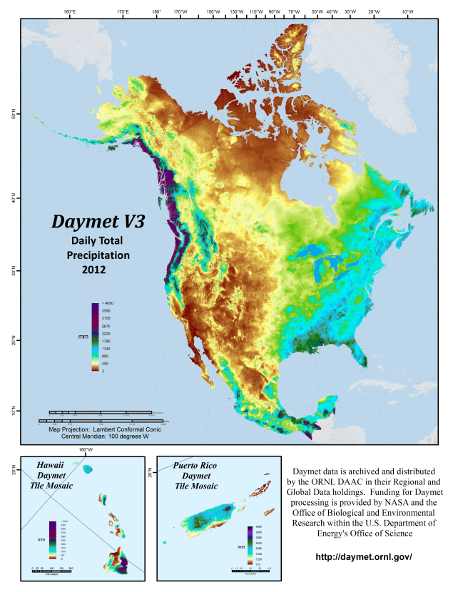

Daymet
Gridded weather parameters for North America
Dataset Characteristics
Spatial Resolution ….. 1km x 1 km
Temporal Resolution ….. Daily
Years Available ….. 1980 – 2016
Spatial Region ….. North America
Daymet Data Products
Variable | Units
maximum temperature | °C
minimum temperature | °C
shortwave radiation | W/m²
vapor pressure | Pa
snow water equivalent | kg/m²
precipitation | mm/day
day length | s/day

Slide 13
Daymet
Access to Daily Data Allows Customized Research Analysis
Customized Climatologies (DJF, NDJ)
Calculation and Departure from “Normal” (30 yr, Decadal)
Spatial and Temporal Analysis of Days Below a “Threshold”
Growing Degree Days w/ selected T_{base}
Output Formats Appropriate to User Needs

Slide 14
Daymet
Web-based access to Daily 1 km data
  Direct download of netCDF files
  Customized tools and services
    Single Pixel Tool
    THREDDS netCDF Subset Service (NCSS)

Slide 15
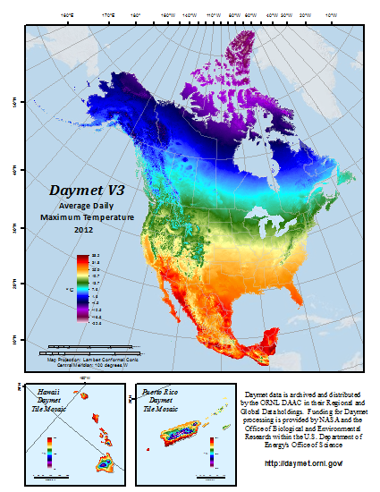
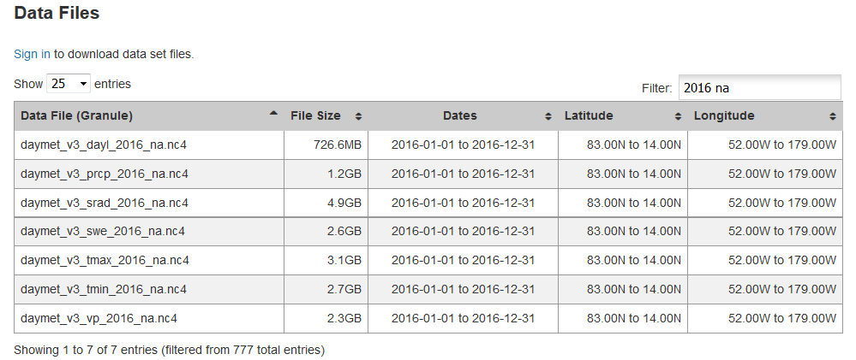
Daymet
ORNL DAAC Direct Data Download
North American Daily Data Files
netCDF4 file format with internal compression
Also available
  Climatological Summaries (netCDF, geoTIFF)
  Spatially Reference XVAL (uncertainty)
~ 17 GB / year

Slide 16
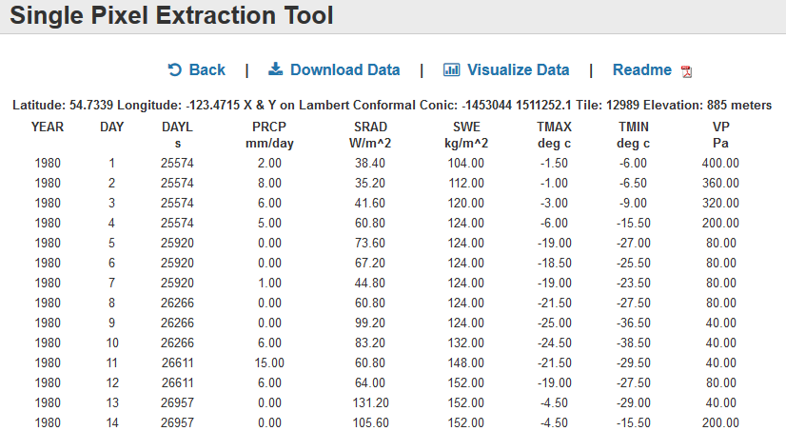
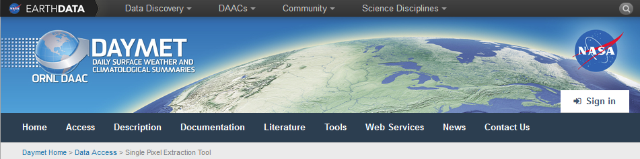
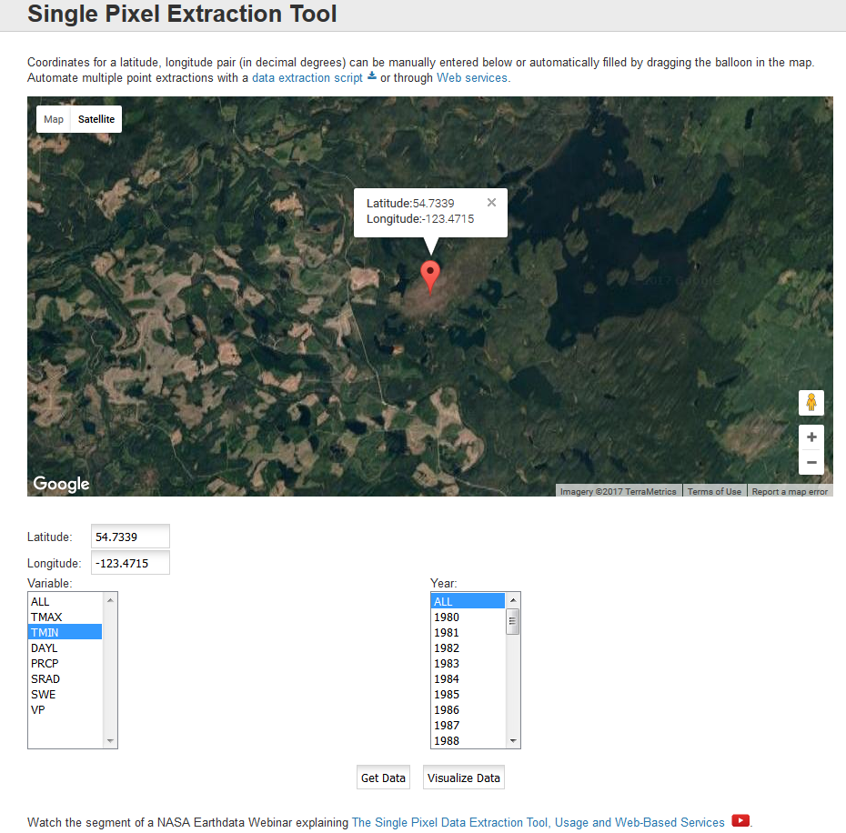
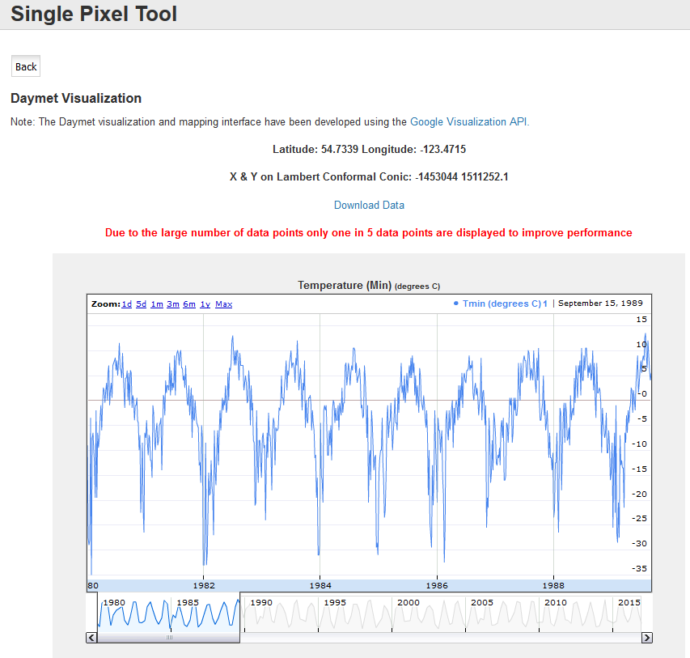
Daymet
https://daymet.ornl.gov/single-pixel/
Automate !

Slide 17
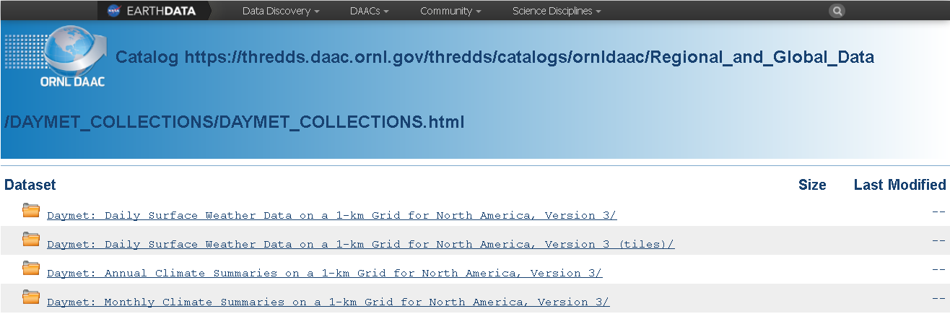
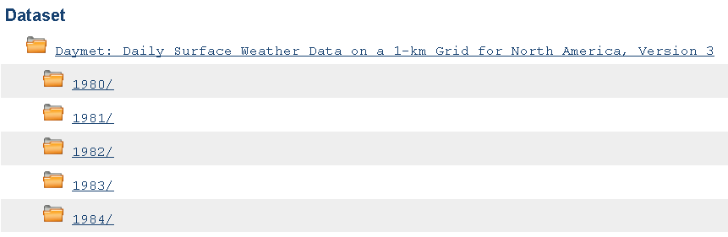
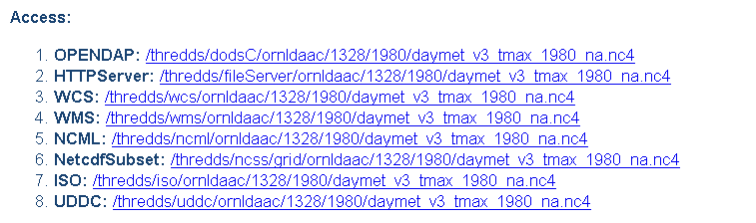
Daymet

Slide 18

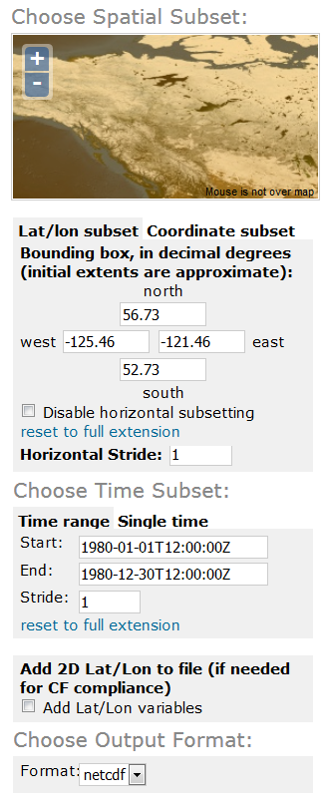
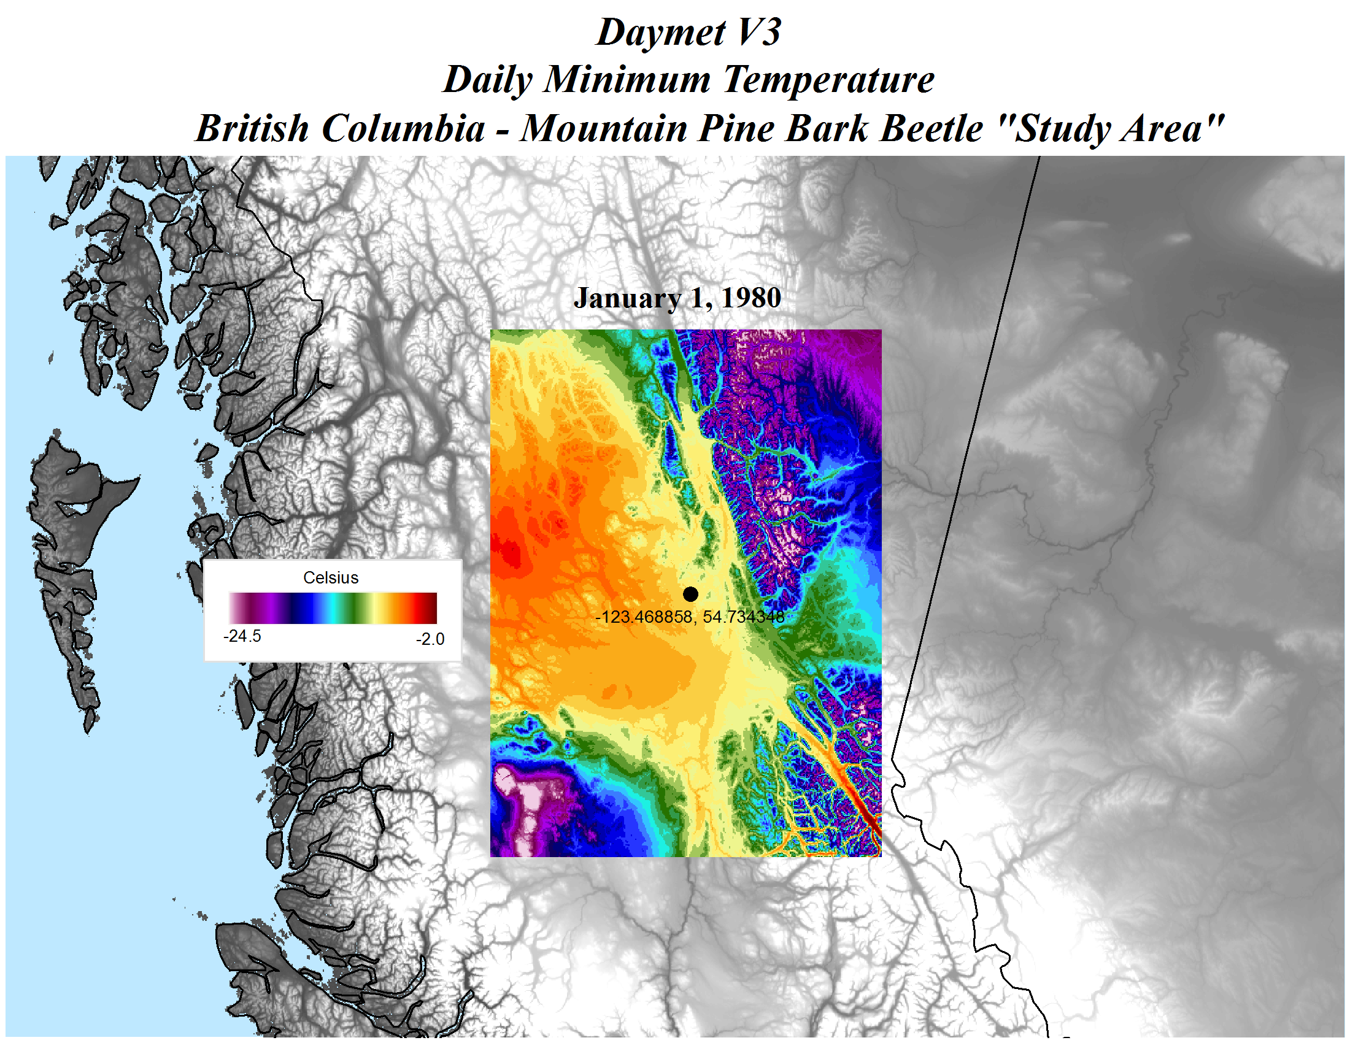
Daymet
Automate !

Slide 19
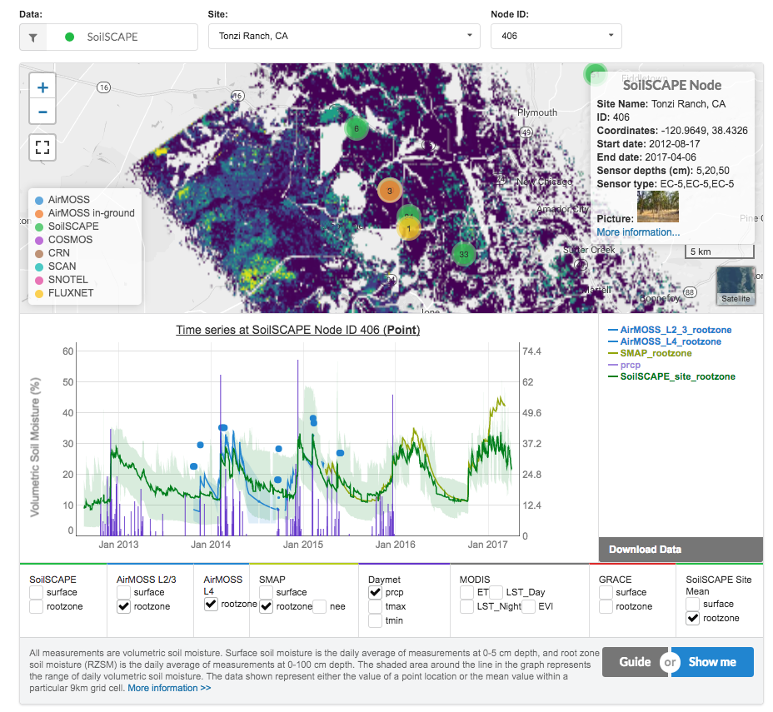
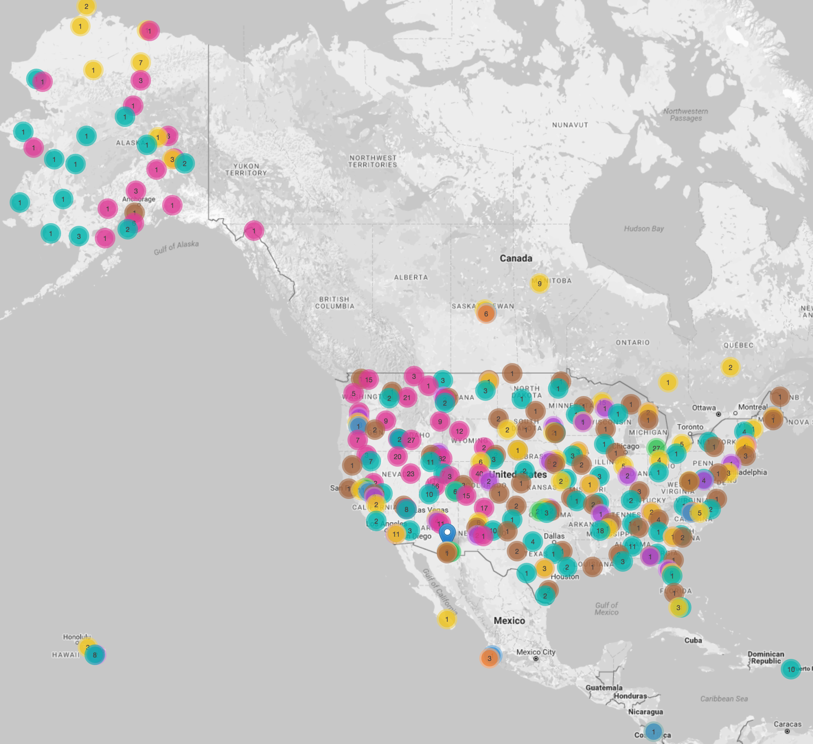
ORNL DAAC Soil Moisture Visualizer
Get SMAP L4, GRACE, precipitation,
and in-ground soil moisture from networks across North America
https://airmoss.ornl.gov/visualize

Slide 20


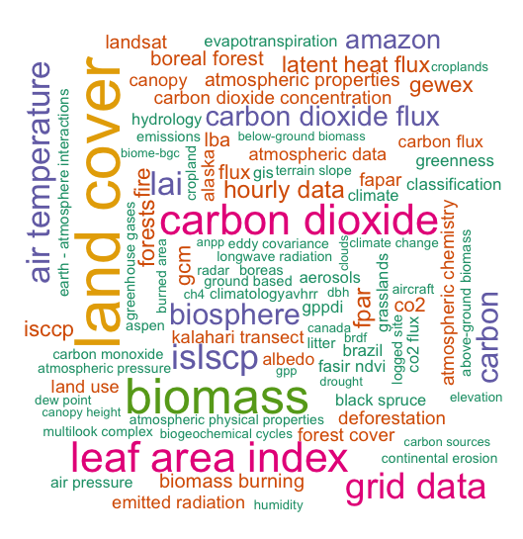
Connect with us for updates
https://twitter.com/ORNLDAAC
https://www.facebook.com/OakRidgeDAAC
Top 100 ORNL DAAC keywords

